Slide 1
Introduction to Numerical Modeling with ANSYS Fluent
Lecture note of
By : Samane Aghaei

Slide 2
Introduction to CFD
What is CFD?
Computational Fluid Dynamics (CFD) is the science of predicting fluid flow, heat and mass transfer, chemical reactions, and related phenomena.
To predict these phenomena, CFD solves equations for conservation of mass, conservation of momentum and conservation of energy.

Slide 3
Introduction to CFD
What is CFD?
CFD can provide detailed information on the fluid behavior:
Distribution of pressure, velocity, temperature, etc.
Forces like Lift, Drag…
Distribution of multiphases
Much more…

Slide 4
Introduction to CFD
Governing Equations
Conservation of Mass
Conservation of Momentum
Conservation of Energy

Slide 5
Introduction to CFD
Governing Equation
Navier-Stocks Equation
Mass Conservation
Momentum Conservation

Slide 6


Discretization
Divide the domain into multiple control volumes or cells
Determining velocity and pressure values at cell centres

Slide 7
Introduction to CFD
Finite Volume Method(FVM)
The computational domain is divided into a finite number of small control volume(cells)
The differential equations are integrated over each control volume
The fluxes, momentum and energy are evaluated at the face of each control volume

Slide 8
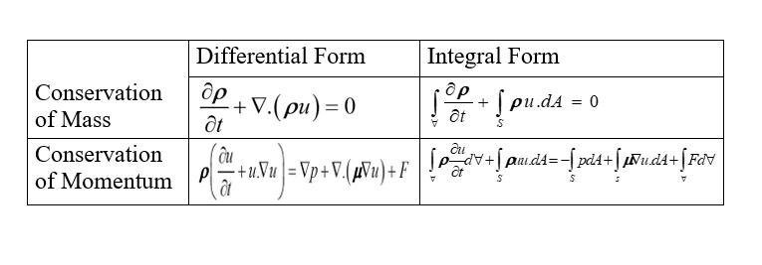
How to derive system of algebraic equations?

Slide 9


Introduction to CFD
Linearization
$$f\left(u\right)=f\left(u+Δu\right)$$
Taylor Series:
$$f\left(u\right)=f\left(u\right)+Δuf^{′}\left(u\right)+\frac{Δu^{2}}{2}f^{″}\left(u\right)+HOT$$

Slide 10
Introduction to CFD
Discretization and Linearization Overview
Differential form of governing equations
Integral form of governing equation
Algebraic equation relating cell-centre value
Linearized algebraic equations relating cell-centre values
Solve iteratively updating guess after each iteration
Stop iterations when imbalances are below tolerance

Slide 11
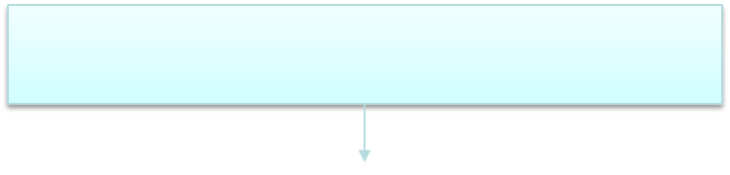
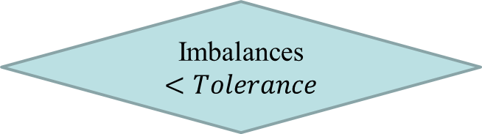
Introduction to CFD
Algorithm for Iterative solutions
Assign guesses values at cell-centres
Tweak guesses values using linearized equations
Calculate aggregate mass and momentum imbalances
Converged
Yes
Imbalances$<Tolerance$
No

Slide 12
Introduction to CFD
How does ANSYS Fluent work?
Pre-analysis
Geometry
Mesh
Model Setup
Numerical Solution
Numerical Results
Verification and validation

Slide 13
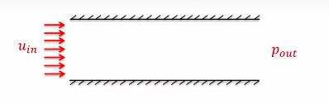
Example: Flow in a Channel
Steady, 2D, laminar, incompressible
Find: Velocity and pressure distribution
Wall friction

Slide 14




Example: Flow in a Channel
Mathematical Model: Governing Equations
Conservation of Mass(Continuity)
$$∇.\vec{V}=0$$
2. Conservation of Momentum
$$ρ\left(\vec{V}.∇\right)\vec{V}=−∇p+μ∇^{2}\vec{V}$$
$$\vec{V}=u\hat{i}+v\hat{j}$$
Unknowns:
$$u\left(x,y\right),v\left(x,y\right),p\left(x,y\right)$$

Slide 15
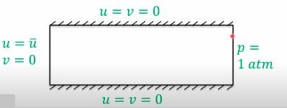
Example: Flow in a Channel
Mathematical Model: Boundary Conditions

Slide 16
End

